Slide 1
Testing Phone Systems
Notes:
Welcome back after lunch. Hopefully everyone is doing good, and not too hangovered. This slide might help with that, if you’ll notice the SWEET graphics.

Slide 2
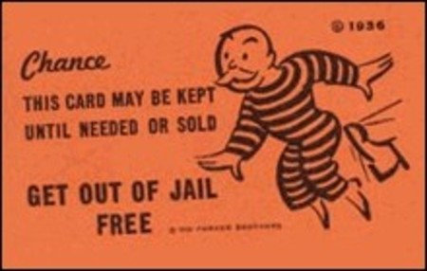
Mandatory Disclaimer
Yep Yep Nope. Yada Yada; Emoticon,
YMMV
YOLO.
“The opinions expressed in this presentation and on the following slides are solely those of the presenter. There is no guarantee on the accuracy or
reliability of the information provided herein.”
Notes:
This slide was REALLY HARD to find a good disclaimer. But don’t be dumb.

Slide 3
Introduction – Deets
Phone Stuff
History / Evolution
Anatomy
How to test
Issue Types
Mapped to OWASP top 10
Fun Tricks
Notes:
Where we're here to talk about
Phone Stuff
More Specifically VoIP and modern phone systems
Few Slides of History / Evolution (nothing too boring or intense) – I’m not going to bore you with this, just a bit of background 3 slides.
How to test
Focusing on Externally testing – but there will be some overlap
Issue Types found within phone systems, and loosely mapped
Some Fun Tricks
Slides are probably on github or slideshare or whatever.

Slide 4

About Me
Day Job
Fun
Presentations
Moved to US in 2000.
Notes:
This is the part where I get to talk about myself.
I work on an offensive sec team, means get to learn a lot and break things.
For fun, I generally like to bike, more in the mountains because tree’s don’t try to kill you.
Some other presentations have done
Wardriving 2005
Hacking with the iPhone 2007?
DevOps. 2009?
Phony Business - CarolinaCon 11 (2015)
Sorry Wrong Number - Defcon 23 (2015)
The Phony Pony - DerbyCon 5.0 (2015)
Gettin' Vishy with it - CarolinaCon 12 (2016)
http://www.kingcounty.gov/help/editorial-style-guide/listings/a.aspx

Slide 5

Notes:
We’ll get some of the Bingo out of the way first.

Slide 6

Notes:
We’ll get some of the Bingo out of the way first.
Another Hangover Inducing
Looking back, the 90’s weren’t all that great.

Slide 7
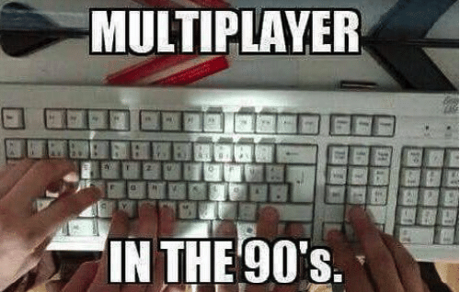
Notes:
For those that have never done this with your bro’s give it a chance.

Slide 8
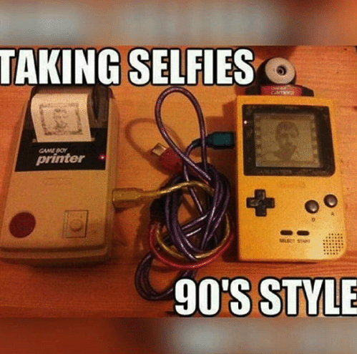

Slide 9
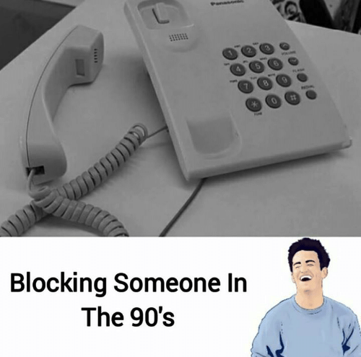
Notes:
If you had an APT this is how you blocked them.

Slide 10
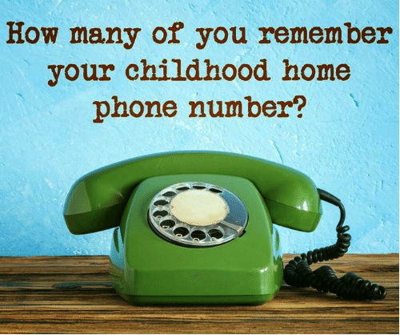
Notes:
Good one for finding out the answer to “What was your first phone number”
People kept phone numbers forever back then.

Slide 11
So who uses Phones?
What industries?
Particularly interesting are: banking/finance, insurance, energy, healthcare, government, military.
Notes:
Pretty much everyone / everywhere. Who doesn’t basically.

Slide 12
History
Sorry, Wrong number DC23
Exploding The Phone (Book) 2013.
Notes:
This is going to be quick
Presentation is going to be more on the digital side.

Slide 13

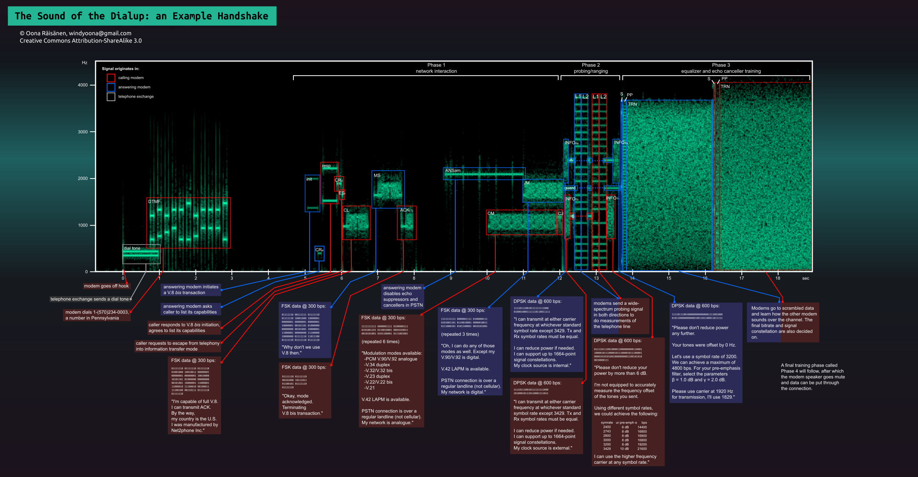
History
https://en.wikipedia.org/wiki/Dial-up_Internet_access
Notes:
I had to include this, We’ll use this example a bit later on though.
How many of you have heard, “get off the internet I need to use the phone” Maybe some of you were lucky enough to have two phone lines.

Slide 14
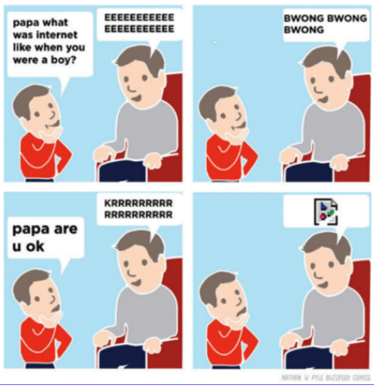
History
1996 ICQ, NetMeeting, SMS (UK)
1998 Yahoo Messenger
1999 MSN Messenger & Asterisk
2001 TeamSpeak & MMS
2002 Yahoo Messenger Chat
2003 Skype Released - MySpace
2007 iPhone
1997 AIM
2005 YouTube
2004 Facebook
Notes:
Growing up with telephones, moved onto the internet age of dial up. Cell Phones / Text SMS became super popular. Pay-as-you-go was huge, at least in the UK.
Timeline
IRC, ICQ, AIM - Those were around, but text based, could transfer files but never do video/audio chat.
~1996 NetMeeting - PITA, IP crappy interface, shoddy webcam support (Win 95 SR2)
1996 SMS (UK) – Palm Pilot, Sony Vaio
1998 Yahoo Messenger
1999 MSN Messenger, 2000 - Big Update. (PC-PC Chat & PC-Phone through two providers)
1999 Asterisk (Not Exactly related to all of this) (Blogger)
TeamSpeak 2001
2000 – Literally Nothing happened in 2000. The segway was invented. Playstation 2. Guess people were pre-occupied with something. 1GHz Computers at home (WHAAAAT) First Camera Phone Built.
2001 – Windows XP, TeamSpeak MMS (Became Popular?)
2002 Yahoo Messenger Video Chat – Doesn’t seem like long ago but then you realize, that’s 15 years ago.
2003 Skype August (MMS & Camera Phones getting popular)
2004 – Facebook, Mobile network expansion EV-DO, camera phone innovations. Web 2.0!
2005 – Youtube (Beginning) Xbox (towards the end)
2006 – Facebook for all. TWITTER!
2007 iPhone
Game Changer
Kindle, DropBox, 1TB Drives, Hulu, Cuda.
QUIZ:
Prior to the iPhone, what do all of those technologies with the exception of asterisk have in common?
- Closed Source
What was the first camera phone built in 2000 called? – Jphone J-SH04. – Who was it made by? SHARP

Slide 15
Recent History
Hangouts
FB Messenger
Signal
Screen Sharing
LiveStreaming
WhatsApp
SnapChat
Kik
etc etc.
Notes:
- Google Hangouts (Voice/Talk) – Integrated into your phone
- FaceBook Messenger got chat, post on peoples walls (added webcam support)
Signal Chat, added video
Screen Sharing / Collaboration has become huge. LiveMeeting, Zoom, UberConf, GoToMeeting, Join.Me
LiveStreaming - Facebook, Twitch.
- WhatsApp, Kik, Snapchat
Everything has a camera / mic on it now.
Smart mirrors.
What’s this got to do with phones?
- One thing that remains is the desire to communicate through text, voice, and media and POTS/PSTN and having phone numbers is still around. The “line” between traditional phone services and the integration of other systems is sort of getting blurry.

Slide 16

Terminology
POP QUIZ
Notes:
PSTN/POTS - Public Switched Telephone Network.
CO line - Central Office Line
PBX - Private Branch eXchange
DTMF - Dual Tone Multi Frequency
Protocols
SIP -
IAX -
XMPP -
Asterisk / PBX Stuff:
Gateway
AGI
AMI
ARI
Extensions
Trunk
Dialplan
Channel
Codecs
GSM, alaw,ulaw, h323, g.722
Graphic: http://blog.securitymetrics.com/2015/04/pci-audit-glossary.html

Slide 17
Terminology
PSTN/POTS
CO line
PBX
DTMF
Protocols
SIP
IAX
RTP
XMPP
Asterisk / PBX Stuff:
Gateway
AGI
AMI
ARI
Extensions
Trunk
Dialplan
Channel
Notes:
Basic Terminology
PSTN/POTS – Public Switched Telephone Network
PBX - private branch exchange
Extensions
Trunk
Protocols
SIP, IAX, XMPP

Slide 18
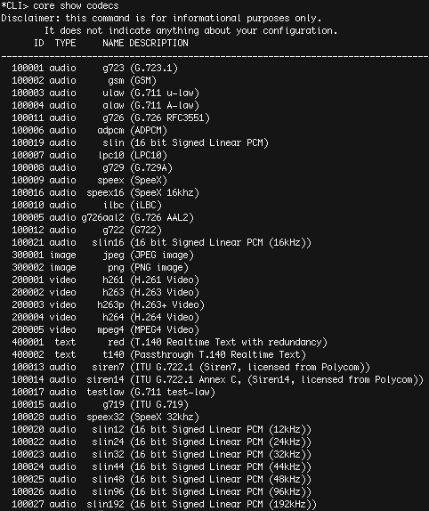
Codecs
Codecs
G.711 – ITU-T
PCM
Alaw
Ulaw
G.711.0
G.711.1
g.722
GSM
Notes:
G.711 – 1972 iToot.
- PCM
- ulaw – North America
- alaw – other countries
Narrowband – 300-3400hz at 8,000 samples/second.
G.711.0 – Approved in 2009
- Compression 50%
G.711.1 – Recommended in March 2008
Wideband embedded extension for G.711 pulse code modulation.
G.722 – 1988
Improved.
https://www.voip-info.org/wiki/view/Asterisk+codecs
https://en.wikipedia.org/wiki/G.711
https://en.wikipedia.org/wiki/G.722

Slide 19
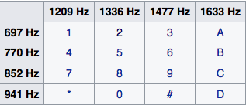
DTMF
Dual Tone Multi Frequency
Can be easily generated
http://www.genave.com/dtmf.htm
https://en.wikipedia.org/wiki/Dual-tone_multi-frequency_signaling
Notes:
What happens when you press the buttons on your phone.

Slide 20
PBX’s
- Why people run PBX’s?
- No longer use switchboards
- Reduce Costs (Think remote offices)
- Cheap Calling
- "Apps"
- IVR's, Voicemail, call queues
- Conferencing
- Directories
Notes:
- Why people run PBX’s?
- No longer use switchboards
- Reduce Costs (Think remote offices)
- Cheap Calling
- "Apps"
- IVR's, Voicemail, call queues
- Conferencing
- Directories

Slide 21
Anatomy
Internal
Cloud / Externally Deployed
Third Party
Notes:
Landscape / Architecture / Anatomy
Internal vs. Externally deployed (Cloud)
Third Party Managed / Hosted

Slide 22
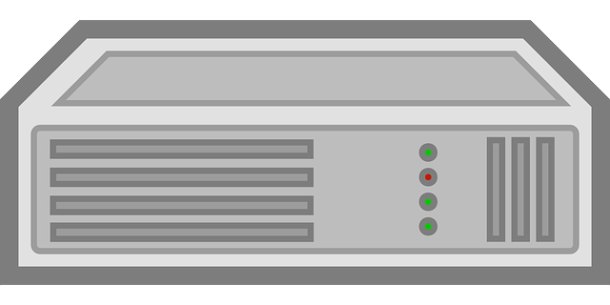

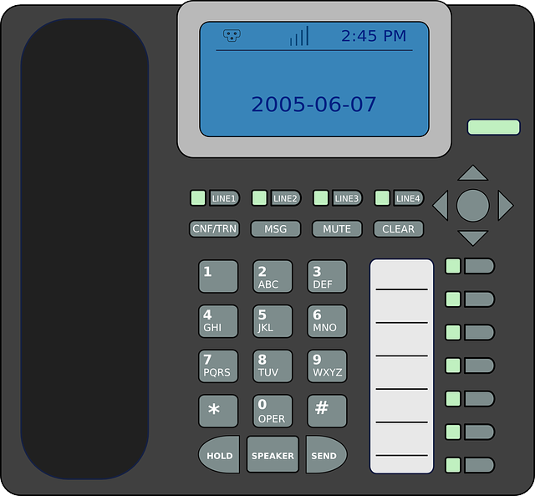
Basic Deployment
PBX
ATA
SIP Phone
SoftPhone
“Phone”
Notes:
Typical of a home / small business setup.
https://pixabay.com/p-25476/?no_redirect
https://pixabay.com/en/switch-router-communication-23320/
https://pixabay.com/en/call-center-call-centre-headphones-2135513/
https://pixabay.com/en/computer-network-router-server-159829/

Slide 23
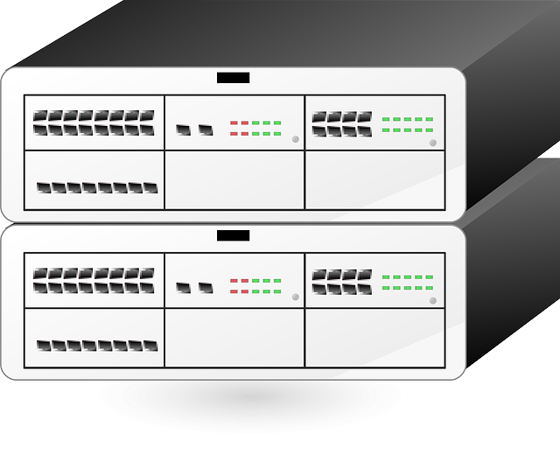


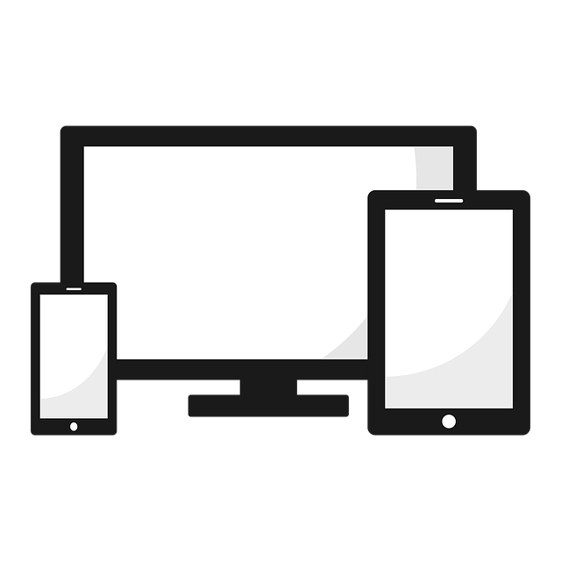

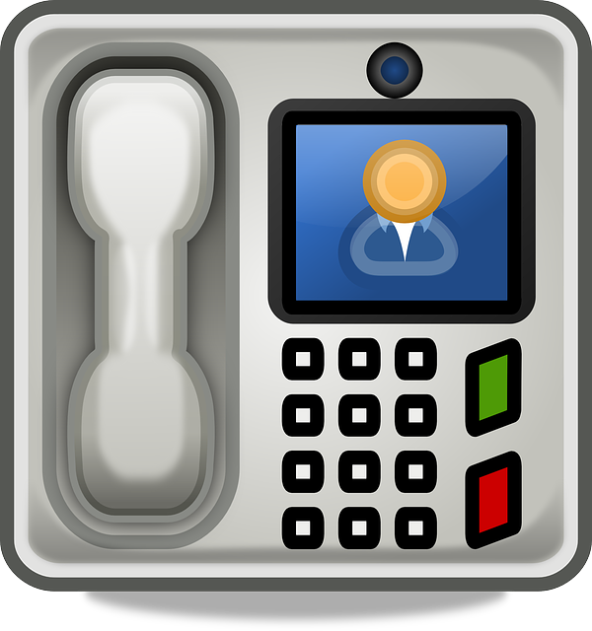
Common Deployment
Provider
Location A
Location B
Provider
PBX
Notes:
Pretty Common Deployment
More Technology
Conferencing
Call center software
Portals
Management
Reporting and Analytics
Mobile
Forwarding
BYOD
Apps
Softphones / Skype
https://pixabay.com/en/monitor-flatscreen-screen-display-23269/
https://pixabay.com/en/gadget-devices-technology-1917227/
https://thenounproject.com/term/conference-call/79985/
https://pixabay.com/en/intercom-talk-back-phone-automation-146123/
https://thenounproject.com/search/?q=voicemail&i=1021504

Slide 24
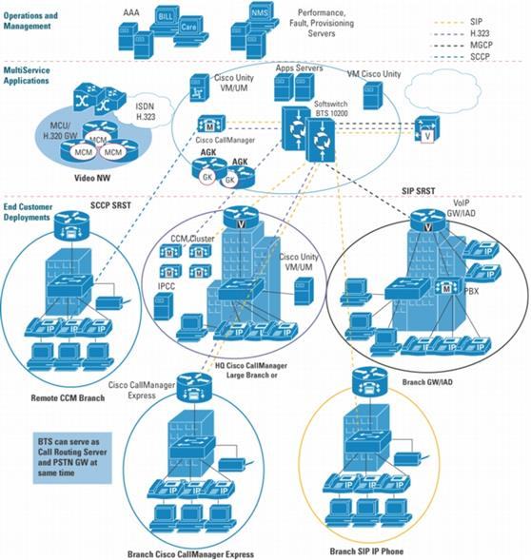
Large
Notes:
This is what a large deployment looks at - we’re going to spend about 30 minutes looking at this.

Slide 25
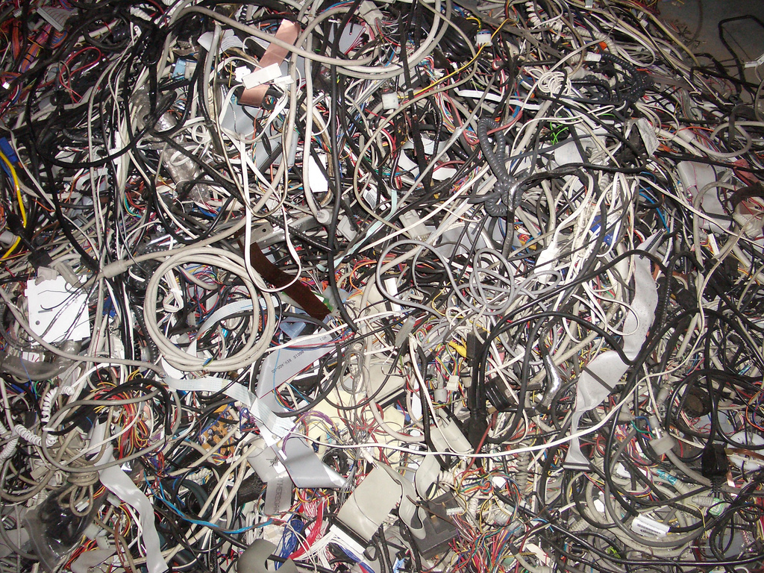
Deployments
Notes:
Just kidding, this is what large deployments generally look like.
https://www.flickr.com/photos/jacktwo/365115251

Slide 26
More Tech
Call Monitoring
Voicemail Transcribing
Call center / Queue
Ring Groups
Call Backs
Portals
Reporting and Analytics
Translations
Voice Biometrics
2FA
Mobile
Forwarding
BYOD
Apps
Softphones / Skype

Slide 27
How?
Step 1) Figure out what you’re testing
Notes:
How to Test
Hardware, software – you name it. PBX’s, Softphones, Apps, protocols, codecs. Mobile is its own beast.
Each require different types of testing and a diverse set of skills is needed.
Relevant testing information
Presentations
Tools (sipvicious etc)
SipSak

Slide 28
Testing
Scope
Blackbox / Whitebox?
Info Gathering
Notes:
Externally Testing
Scope. Depends on your type of engagement.
- Stealthy
- Detection
- What’s out of limits?
Information Gathering / Fingerprinting
- Gather phone numbers from OSINT
- Grab Phone Numbers from Web / Directories. Look for patterns
- Port Scans (Noisy, time consuming)
- Shodan
- Use the Web
- Whois has information
- http://freecarrierlookup.com/

Slide 29
Testing
Scope
Blackbox / Whitebox?
Info Gathering
OSINT
Grab Phone Numbers from Web / Directories.
Look for patterns
Port Scans
Shodan
Use the Web
Whois has information
Notes:
Externally Testing
Scope. Depends on your type of engagement.
- Stealthy
- Detection
- What’s out of limits?
Information Gathering / Fingerprinting
- Gather phone numbers from OSINT
- Grab Phone Numbers from Web / Directories. Look for patterns
- Port Scans (Noisy, time consuming)
- Shodan
- Use the Web
- Whois has information
- http://freecarrierlookup.com/

Slide 30
Externally Testing
Testing Via POTS
Regular Phone. Sit and press buttons
Modems and AT commands
Soft Phones
Any of the major ones
Ekiga, Twinkle ETC.
Automatable / Scriptable
SipCLI
Sip.Js & JSSip
MJSip
Use a PBX
Notes:
Ways to test externally via POTS.
- Regular Phone. Sit and press buttons
- Modems and AT commands
- Soft Phones
Automated / Scriptable Softphones or SIP clients.
All Pretty tedious
Probably one for every language
Scriptable / Automatable SoftPhones
- http://www.jssip.net/
- http://www.mjsip.org/
- https://github.com/usnistgov/jsip
- Sipjs.com
Or Use a PBX

Slide 31
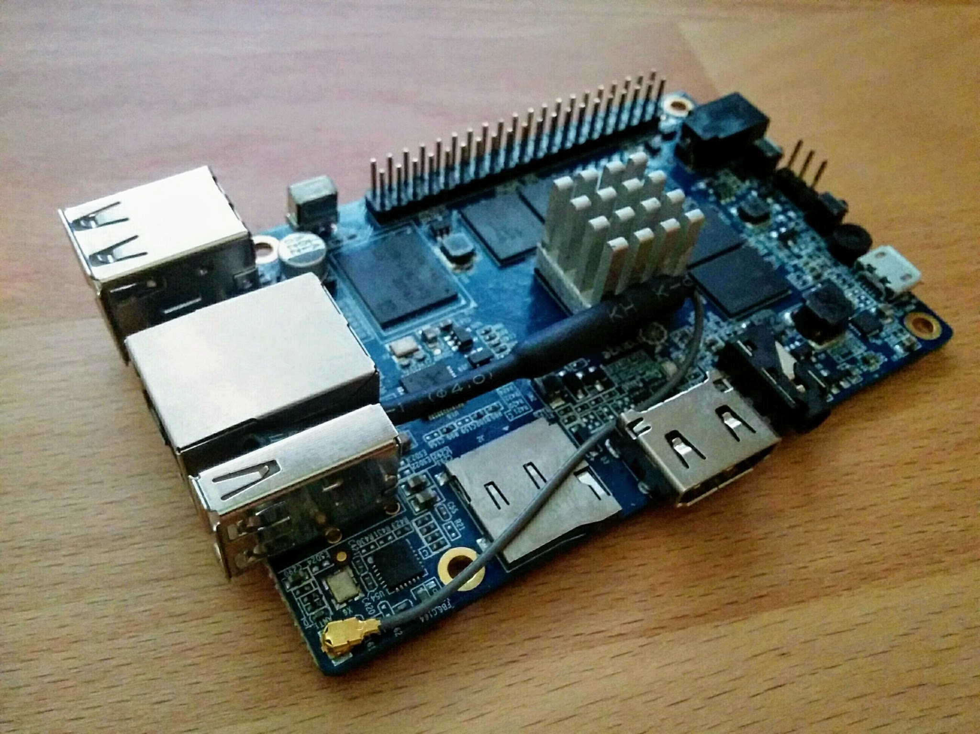
My Testing Setup
OrangePi 2E
Decent Specs
Portable
Notes:
OrangePi - Any system would work
Why I used OrangePi.
Fast, have decent amount of ram
Quad Core 1.6GHz
2GB Ram
16GB Onboard Flash
Gigabit Ethernet
Wifi
separate usb/eth, IR, onboard mic
Fairly Portable
Put in a Box
Take it with you
doesn't need much to run a demo
Same reason presentations have pictures - people like to look at things

Slide 32
Software
Armbian
Asterisk
Scripting Utilities
Notes:
We’ll get into this more a bit later.

Slide 33
Issue Types
Notes:
Who can name the OWASP top 10 (DRINK)
If someone asks what year (Free Drink too)
Types of Issues (2013)
A1: Injection
A2: Broken Authentication and Session Management
A3: Cross-site Scripting
A4: Insecure Direct Object References
A5: Security Misconfiguration
A6: Sensitive Data Exposure
A7: Missing Function Level Access Control
A8: Cross-Site Request Forgery (CSRF)
A9: Using Components with Known Vulnerabilities
A10: Unvalidated Redirects and Forwards
2017:
A1 Injection
A2 Broken Authentication and Session Management
A3 Cross-Site Scripting (XSS)
A4 Broken Access Control (As it was in 2004)
A5 Security Misconfiguration
A6 Sensitive Data Exposure
A7 Insufficient Attack Protection (NEW)
A8 Cross-Site Request Forgery (CSRF)
A9 Using Components with Known Vulnerabilities
A10 Underprotected APIs (NEW)

Slide 34
Types of Issues 2013
A1: Injection
A2: Broken Authentication and Session Management
A3: Cross-site Scripting
A4: Insecure Direct Object References
A5: Security Misconfiguration
A6: Sensitive Data Exposure
A7: Missing Function Level Access Control
A8: Cross-Site Request Forgery (CSRF)
A9: Using Components with Known Vulnerabilities
A10: Unvalidated Redirects and Forwards
BONUS: Insufficient Anti-automation
Notes:
Types of Issues (2013)
A1: Injection
A2: Broken Authentication and Session Management
A3: Cross-site Scripting
A4: Insecure Direct Object References
A5: Security Misconfiguration
A6: Sensitive Data Exposure
A7: Missing Function Level Access Control
A8: Cross-Site Request Forgery (CSRF)
A9: Using Components with Known Vulnerabilities
A10: Unvalidated Redirects and Forwards
BONUS: Insufficient Anti-automation

Slide 35
A1: Injection
Causes : Web, Voice, SIP, DTMF
Result:
XSS
Buffer Overflows
Log Contamination
Notes:
Mostly if not all on the application layer.
Causes : Web, Voice, SIP, DTMF
Result : XSS, Buffer Overflows, Log Contamination
Demo Latest Buffer overflow (no exploit, just crash)

Slide 36
A2: Broken Authentication & Session Management
Mostly Authentication
Lack of SSL/TLS for SIP
https://wiki.asterisk.org/wiki/display/AST/Secure+Calling+Tutorial
Notes:
Externally Testing, if SIP is open, and controls aren’t in place, people can guess users / passwords.
We’ve seen it before.
Lack of SSL/TLS (Externally testing) going to be difficult, but if you can put yourself in the middle on an internal test, or sniff – break into other tools (logs) there might be some interesting credentials found.
Authorization technically falls into this - more on that later.
TLS was added in asterisk 1.6

Slide 37
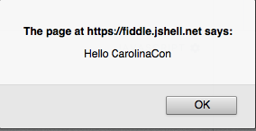
A3: Cross-site Scripting
Somewhat covered by injection
Notes:
Believe it or not
Have done a demo before, everyone knows what XSS is.
This could be interesting with some payloads with frameworks like SipJS. It’s also something I want to work on in the future.

Slide 38
A4: Insecure Direct Object References
A direct object reference occurs when a developer exposes a reference to an internal implementation object, such as a file, directory, or database key. Without an access control check or other protection, attackers can manipulate these references to access unauthorized data.
Notes:
Hardest for me to come up with something for
Man, these slides are a big disappointment so far right?

Slide 39
A4: Insecure Direct Object References
http://example.com/app/accountInfo?acct=notmyacct
Given that example, this can be translated into a bad configuration.
Either Extensions or AGI Script / App
Related to A5
Notes:
Don’t have an example, but user dials in, call gets answered or prompted, then the user enters another phone number that gets externally routed.

Slide 40
Intermission
Notes:
Don’t have an example, but user dials in, call gets answered or prompted, then the user enters another phone number that gets externally routed.
What is A5? Misconfiguration (Drink)

Slide 41
A5: Security Misconfiguration
Pretty common
SIP allowguest – Default = yes
4 Digit passwords for SIP Clients
Conferencing
Default passwords
Weak Passwords
Misconfigured Dial plans & AGI’s
Notes:
Very Common, Not an all inclusive list.
SIP Allowguest, this allows any one to connect.
4 Digit passwords goes back
Conferencing can be misconfigured
- Conferencing Codes, Dialouts, dial in.
Default and Weak Passwords
For portals, voicemail, SIP clients

Slide 42
A6: Sensitive Data Exposure
Voicemail
Conference Calls
Information not available elsewhere
Similar to the User/Password combination enumeration
Corp Directories
Full Names, E-Mails
Schedules, out of office
Notes:
Voicemail depends on who you talk to
Conference Calls
Information
CC #'s, Account Numbers, Verification Pin's
Caller information, peer/session information
Corp Directories
On system –
logs, tons of stuff.

Slide 43
A7: Missing Function Level Access Control
Caller ID Spoof
User logs in, tries username / pass, fails tries another. Hangup
Systems like voicemail that allow userid, password separate and prompt for username again is an issue
Potential with misconfigurations, if put back into another context.
Reasonable Use
Notes:
Anyone with network access can send your application a request. Could anonymous users access private functionality or regular users a privileged function?
This applies to PBX’s
Caller ID Spoof, different responses (like user agents)
- have heard of people getting different responses based on inbound number
- don’t trust the caller id
Potential with misconfigurations – if put back into another context but is authenticated, they can perform actions that maybe they weren’t supposed to be able to.
Reasonable Use
Does your system check that the phone number is doing a reasonable amount of lookups?

Slide 44
A8: Cross-Site Request Forgery (CSRF)
Vendors
Web portals and configuration pages are often vulnerable
In from a phone sense not directly applicable
Notes:
Exploits the users trust in the service
Especially Vendors
When paired with XSS – it’s pretty devastating.
If you did your enumeration properly, that shouldn’t be too hard to figure out
We’ll get into a situation similar to CSRF a bit later

Slide 45
A9: Components with Known Vulnerabilities
A9: Using Components with Known Vulnerabilities
Notes:
PBX
Don’t have time to cover every PBX in the presentation, but will get some statistics on the known vulnerability types across the major vendors.
Cisco, Avaya, Lucent Technologies, Northern Telecom (NORTEL), Rolm/Siemens, NEC, GTE, Intecom, Fujitsu, Hitachi, Mitel, Digium (Asterisk)
AST Mailing List
Others
Types of known CVE's against these
Listings / Resources for each (github compiled list)
Of course, this is not just limited to the PBX
All components
Soft Phones
SIP Phones
ATX Adaptors
PoE
Everything in between

Slide 46
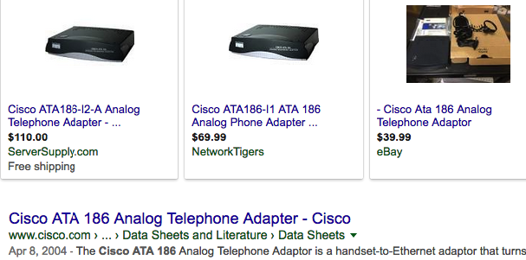
A9: Components with Known Vulnerabilities
Notes:
http://seclists.org/bugtraq/2002/May/92

Slide 47
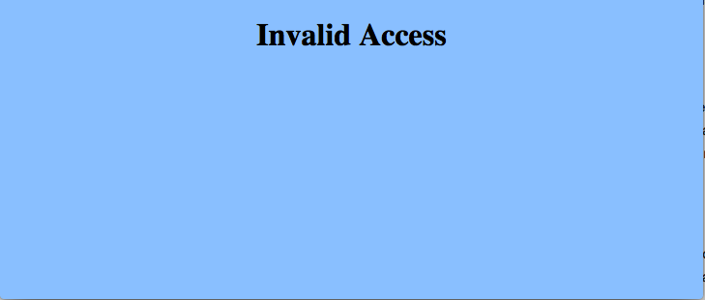
A9: Components with Known Vulnerabilities
Notes:
http://seclists.org/bugtraq/2002/May/92

Slide 48
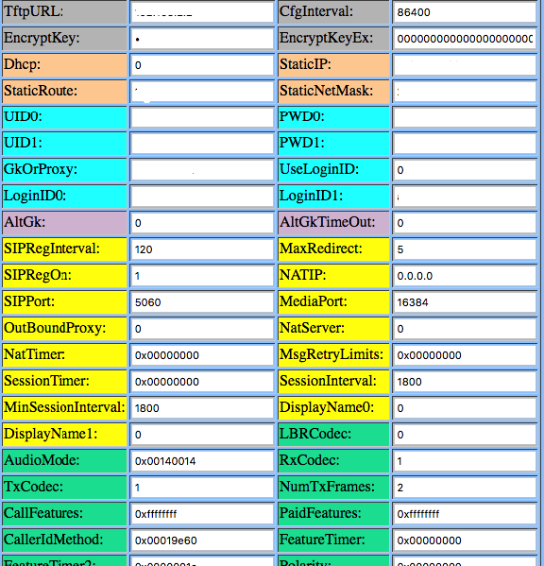
A9: Components with Known Vulnerabilities
Notes:
http://seclists.org/bugtraq/2002/May/92

Slide 49
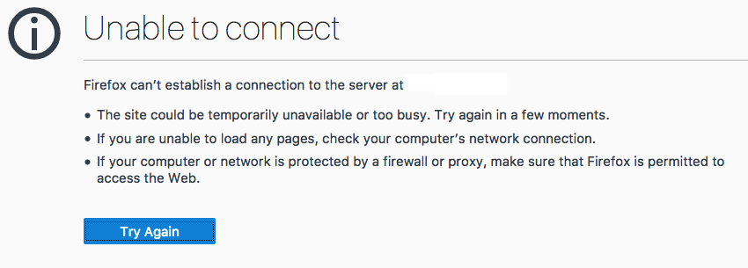
A9: Components with Known Vulnerabilities
Notes:
http://seclists.org/bugtraq/2002/May/92

Slide 50
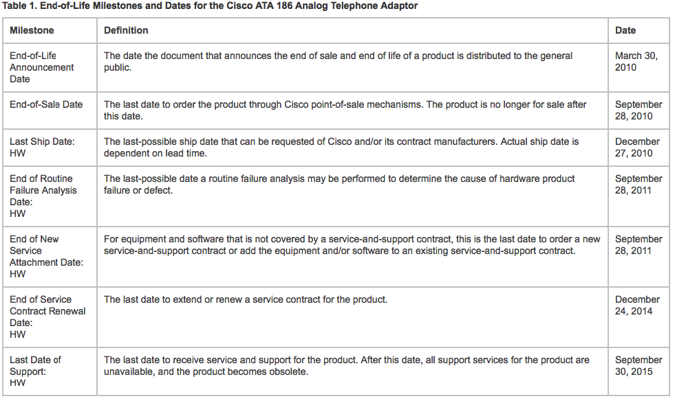
A9: Components with Known Vulnerabilities
http://www.cisco.com/c/en/us/products/unified-communications/ata-180-series-analog-telephone-adaptors/end_of_life_notice_c51-585199.html
Notes:
http://www.cisco.com/c/en/us/products/unified-communications/ata-180-series-analog-telephone-adaptors/end_of_life_notice_c51-585199.html

Slide 51
A9: Components with Known Vulnerabilities
How does this apply?
Notes:
Pretty sure CSRF would work on this portal (What OWASP number is it? Wasn’t that long ago - free drink A8 )
If any of the recent events are anything to go by it’s hard to patch everything.

Slide 52
A10: Unvalidated Redirects and Forwards
Common on the Web
https://foo.bar/jump.php?url=http://www.google.com
PBX/IVR - Tricky but could have a higher impact
Bypass queues
Notes:
Common Web
- Malware / Forwards to other sites
PBX/IVR - Tricky but can have a higher impact
Loops
Functionality
Trunk Tie-up / Resource Exhaustion
Outbound Calls (Fraud)
CID Lookups (DoS/fraud)
Call me backs
- Potential ability to bypass queues if you hear tones when being transferred.
Similar to A3
Potential Vector: Attacker Calls Call Center. Enters a bad phone number for call me back queue.

Slide 53
BONUS: Insufficient Anti-automation
Related to A5, A6, A10.
Brute Force
Services / “Apps”
Passwords
Extensions
Long timeouts
Notes:
Insufficient Anti-automation
Related to: (Drinks?)
A5 Security Misconfiguration
A6 Sensitive Data Exposure
A10 Unvalidated Redirects and Forwards
Brute Force
Extensions, Voicemail, Conference Codes, Leader Codes, Accounts. Corp directories, Passwords
A10 - Unconfigured / long session timeouts for menu browsing – trunk exhaustion

Slide 54
OWASP Mapping
A1: Injection
A3: Cross-site Scripting
A4: Insecure Direct Object References
A5: Security Misconfiguration
A6: Sensitive Data Exposure
A8: Cross-Site Request Forgery (CSRF)
A9: Using Components with Known Vulnerabilities
A10: Unvalidated Redirects and Forwards
BONUS: Insufficient Anti-automation
1: Security Misconfiguration
2: Broken Authentication and Session Management
3: Injection
4: Using Components with Known Vulnerabilities
5: Insecure Direct Object Reference
6: Missing Function Level Access Control
8: Sensitive Data Exposure
9: Insufficient Anti-Automation
10: XSS
11: CSRF
7: Unvalidated Redirects and Forwards
A7: Missing Function Level Access Control
A2: Broken Authentication and Session Management
Notes:
This is my take on the OWASP list as it applies to phone systems, I have no evidence or research into this, but this to me at least makes more sense as far as I’m concerned, it’s up for debate

Slide 55
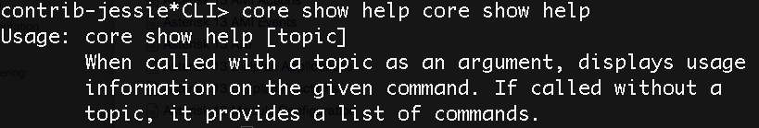
Using Asterisk
Making a VagrantVM
Soft Phone
Console
AGI
https://wiki.asterisk.org/wiki/display/AST/Asterisk+13+Command+Reference
Notes:
Idea is removed all the stuff that’s not needed, make it simpler to get up and running. Once configured you can use the console, same way you’d use metasploit, or router only worse command reference.
Any of the softphones
AGI

Slide 56

Scenario
Notes:
Scenario Story:
My day job gave me the opportunity to co-test our corporate phone system. I was getting nowhere with menus and prompts and social engineering out of scope, and I had an idea for a MITM with no idea if it would work. I decided to write a proof of concept tool, and was able to demonstrate how easy it is for a malicious actor to target clients, customers, or employees. While nothing new from an attack perspective it gained the right type of attention to look for a solution.

Slide 57
Vectors
Two Vectors
A. Fat Finger Squat
B. Spoofed Target Vish

Slide 58
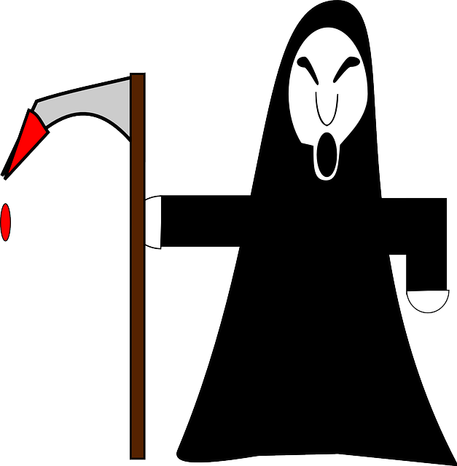



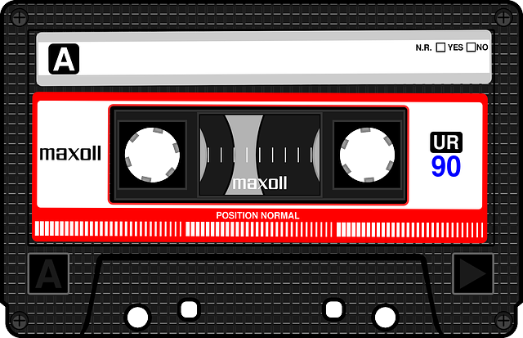
Vector A - Fat Finger Squat
Notes:
Vector A: Pranksters are familiar with this one, and I like to call it the Fat Finger Dial. It is relatively easy to find and purchase numbers with one off digits and easy to mis-dial numbers. All the attacker has to do is sit and wait for the calls to come in and forward the calls while intercepting. This method works particularly well as caller ID is also passed through.
https://img.clipartfest.com/6176e941e70084607b3273f57c4ddadd_hacker-clipart-free-download-clip-art-free-clip-art-on-clipart-hacker_1028-2400.png
http://4.bp.blogspot.com/-BpmOd5X9ua0/VlIaS972kKI/AAAAAAAAC_8/n_hIogSGyiA/s1600/android%2Bhacker.png
https://pixabay.com/p-151599/?no_redirect
https://pixabay.com/en/compact-cassette-musicassette-mc-157537/

Slide 59

Notes:
http://i.ytimg.com/vi/evvj6uNzTPE/hqdefault.jpg

Slide 60
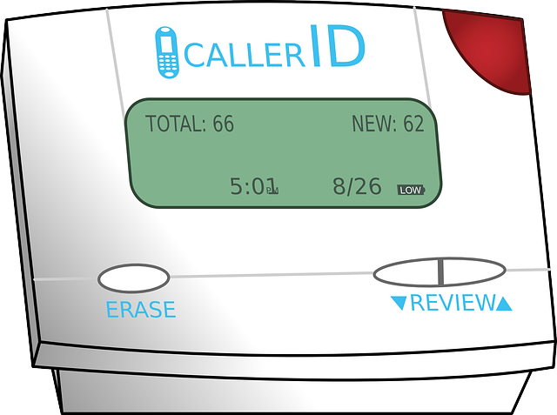



Vector B – Spoofed Target Vish
Spoofed CID
Talk Recording Direct
Hello Can I help?
Notes:
Vector B: The target receives a spoofed call from a legitimate business number from the attacker.
The imposter has something relevant to the targets needs. The target is then prompted for action and transferred to the the correct legitimate call center line, all seems fine except the target is still being eavesdropped by the attacker.
https://pixabay.com/en/phone-telephone-communication-160431/
https://pixabay.com/en/caller-id-caller-identification-cid-33523/
https://pixabay.com/en/lightning-bolt-icon-symbol-power-27588/

Slide 61
Vector B
Demo
Notes:
Vector A: The target receives a spoofed call from a legitimate business number from the attacker. The imposter has something relevant to the targets needs. The target is then prompted for action and transferred to the the correct legitimate call center line, all seems fine except the target is still being eavesdropped by the attacker.

Slide 62
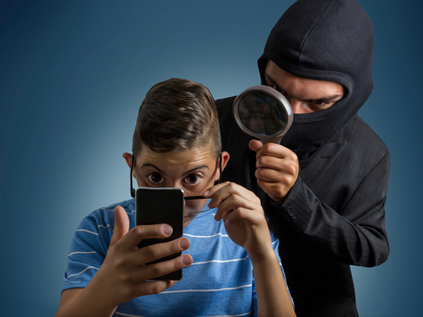
Result
Left with a Recording
What does that contain?
Notes:
You've just recorded a session that you’ve either “intercepted” or someone dialed into
What does that recording contain and what do you do next?
That depends on the target system -
Generally there would be voice or some sort of tones played through.

Slide 63
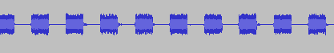
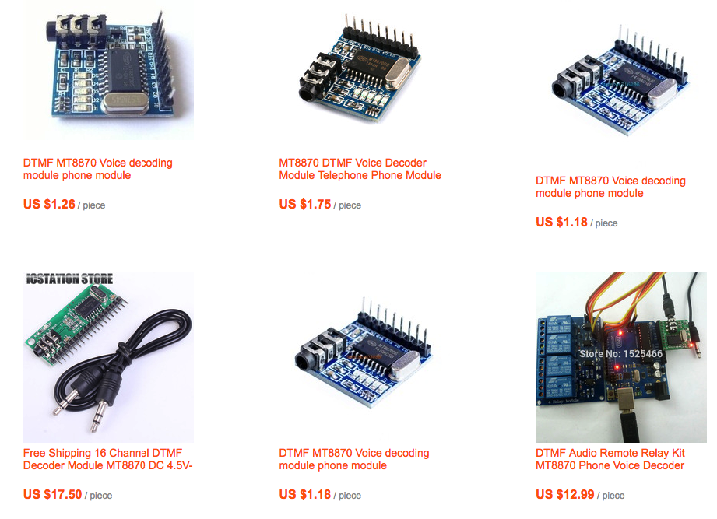
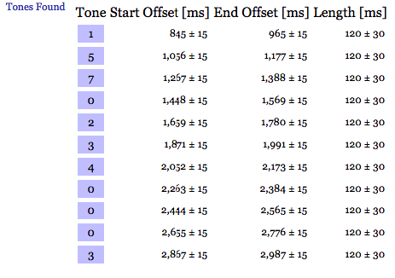
What’s that Sound?
Software
- DTMF Decoding Software
- Online (dialabc)
Hardware Decoder with
ATA or line out
http://dialabc.com/sound/detect/index.html
Notes:
Decoding DTMF digits
Codec Issues / Reliability
But, that generally doesn’t matter if the content in question is true “IVR”. Or if it’s DTMF only and repeats the number back to you there is an issue.
- Other potential ways it can be used
15702340003

Slide 64
Phreak Me
PhreakMe (GPL or other OpenSource License)
Overview
Last Years Changes
Created Rest API
Added SET Module that uses Rest API
Added Web Interface (Still working on)
More Changes to come

Slide 65
More Changes
Re-engineer
Functionality:
MultiStep Prompts
New Vectors to add
Expand API
Notes:
Re-engineer aka start over from scratch.
Multi Step Prompts
New Vectors & Functionality
- Conference Calling
- Some of the testing methods
Expand the API
So many ideas, so little time

Slide 66

Wrap Up
Notes:
I’d like to see more people from 2600 get interested in phone systems again.
What I was trying to get at with the evolution and history is we’ve seen things progress really quickly.
somehow phone systems are still relevant and people still have phone numbers.
Hopefully this was useful, gave some ideas or insight. I think I covered everything that I said I covered. If you’ve got ideas of more stuff that could be added, catch me afterwards.
http://cdn.quotesgram.com/small/38/43/981259558-Thank-You-for-your-Patience.png

Slide 67
Questions?
Notes:
Other than that are there any questions on anything?

Slide 68


